Slide 1


Lumbago Edge Bank
Investigating Fraud Utilising Advanced Analytical Techniques
NBS BAC Hackathon
VSLAM
Ananya Balehithlu | Bai Shun Yao | Max Tan Zheyuan
Tan Kit Hon, Luke | Vinay Krishnaa Vinod

Slide 2
01
02
Table of Contents
03
04
05
Scope
Situational analysis & interpretation
Risk Profiles
Actors we are looking out for
Analysis Process
How we can identify these actors
Outcomes & Insights
The impact these actors make
Recommendations
How we can deal with these actors

Slide 3
01
Scope
Scope

Slide 4





Situational Analysis & Our Interpretation
Situation:
Cause:
Effect:
Whistleblower Fraud Accusation
Unsatisfactory current salaries
Alleged ‘Defrauding’
Involving accounts payable, employee expenses and the use of corporate credit cards.
Interpretation
Approach
Due to financial constraints and ease of defrauding, employees might engage in fraudulent activities in order to ease their financial struggles
Utilising advanced analytics techniques, comb through accounts payable, expenses and credit card transaction data to identify suspicious activities that render financial advantages to employees
Develop Risk Profiles
Scope

Slide 5
02
Risk Profiles
Risk Profiles

Slide 6

Risk Profiles
Disruptive Actors
Ghost Actors
Malicious Actors
Invalid entries
Fake employees/vendors
Insiders with malicious intent
Risk Profiles

Slide 7
Disruptive Actors
People who make invalid entries. Entries do not agree with data context
Examples of invalid entries include:
Leaving transaction date empty
Phone number contains alphabets
Numeric names
Risk Profiles

Slide 8
Ghost Actors
Actors that have valid entries, but are not part of the organisation. This occurs mainly due to a lack of proper access control. Examples of such fraud are:
Bank’s money is flowing out to outsiders
Outsiders are initiating transactions without the proper authority
Expenses are being incurred without valid tax codes
Risk Profiles

Slide 9
Malicious Actors
Actors that are part of the company but have abused their authority to embezzle funds from the bank. Examples of such fraud includes:
Setting negative value transactions to cover up the previous transactions
Making transactions during leave
Making transactions after leaving the company
Malicious actors will always be switching up their methods to cover up for their illegal activities
Risk Profiles

Slide 10
03
Analysis Process
Analysis Process

Slide 11
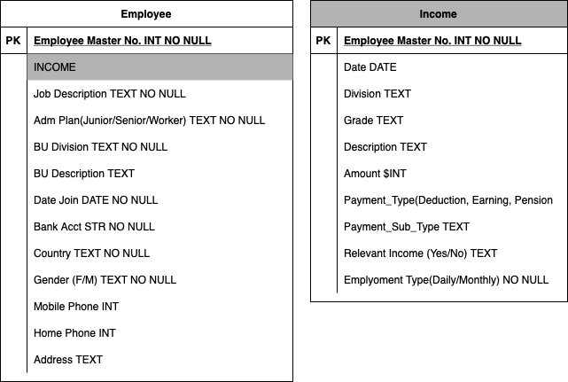
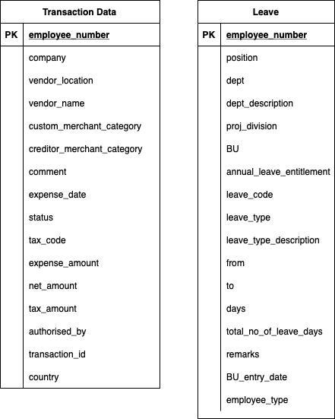
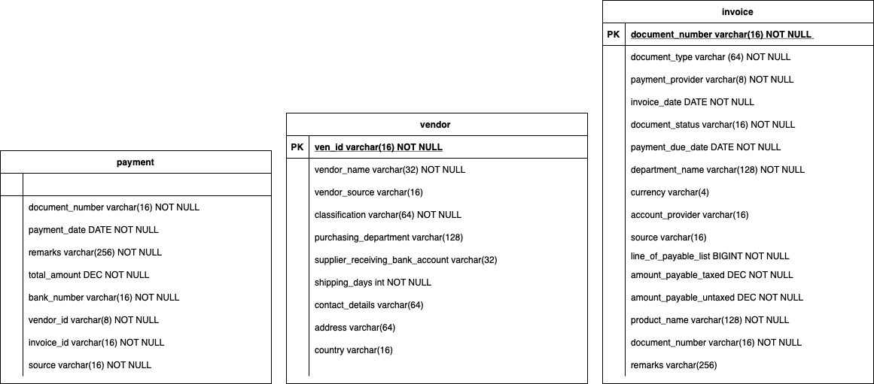
Normalising Data
Original Data
How data was originally organised:
There is a need to re-organise data for efficient analysis
Analysis Process

Slide 12
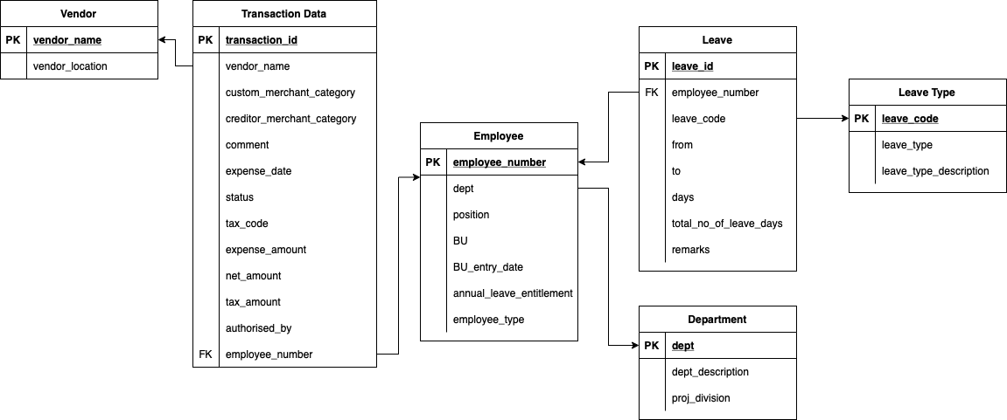
Normalising Data
Decomposing Data (Normalisation)
Process
Identify important attributes
Remove redundant data
Many columns, Messy
Allows us to:
Normalisation
Conduct multi-faceted analysis on the same set of data
Flag out invalid entries (Good starting point for analysis)
Explicitly present association → decomposition of data does not mean we will lose association
Clean, organised data
Analysis Process

Slide 13
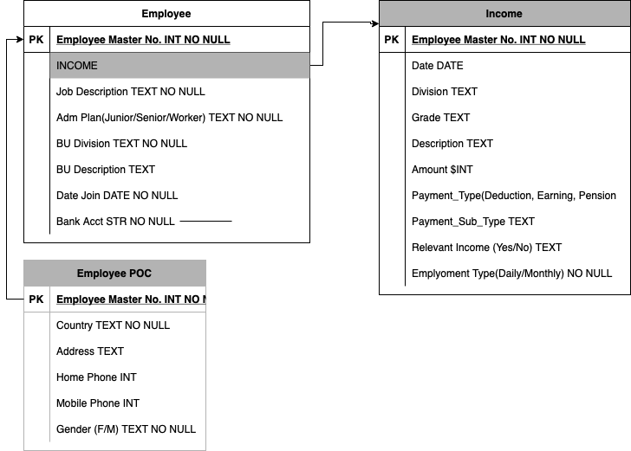
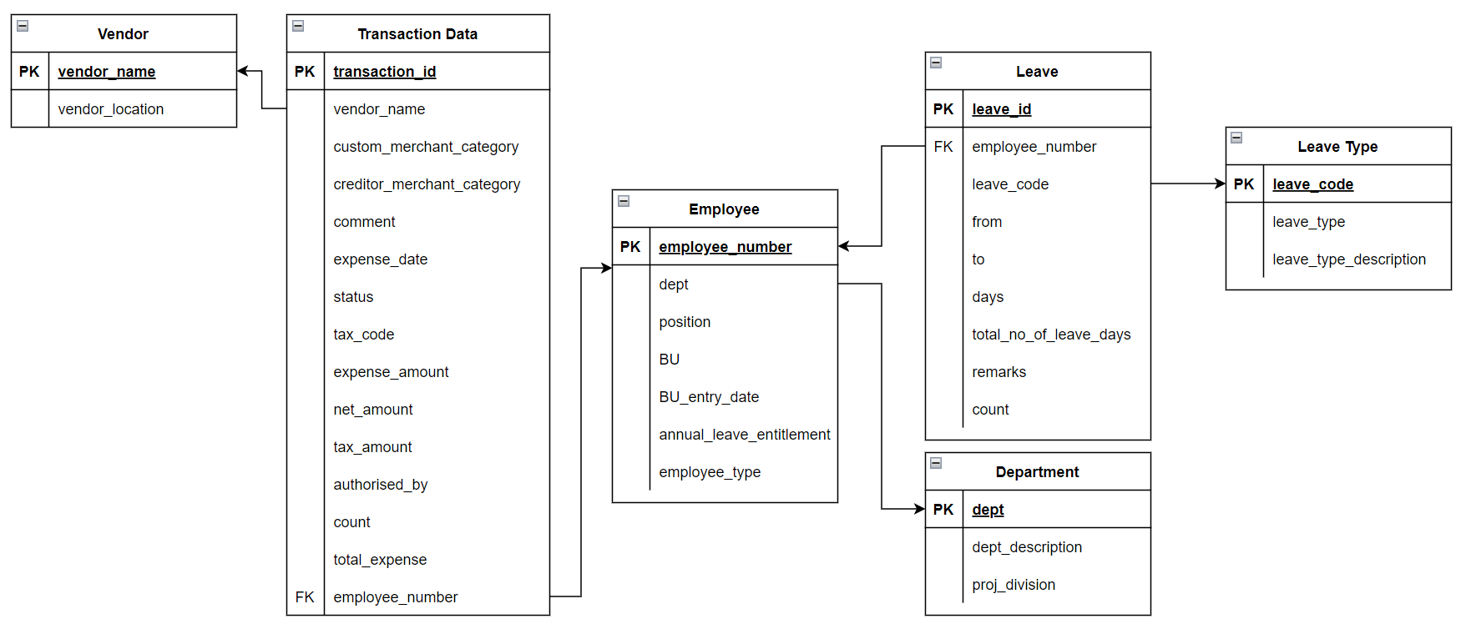
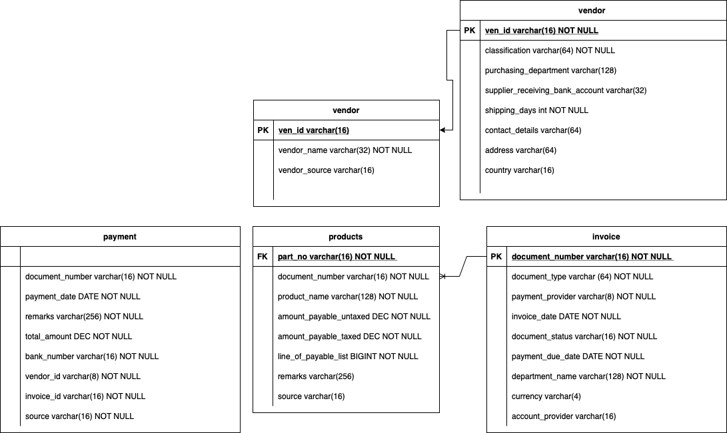
Normalising Data
Normalised Data (Re-organised)
Now analysis can be performed on the respective tables.
Analysis Process

Slide 14
Disruptive Actors
Proposed Checks & Rules
Invalid transaction IDs (Credit Card Data)
Invalid employee numbers (Credit Card Data)
Invalid tax codes (Credit Card Data)
Analysis Process

Slide 15
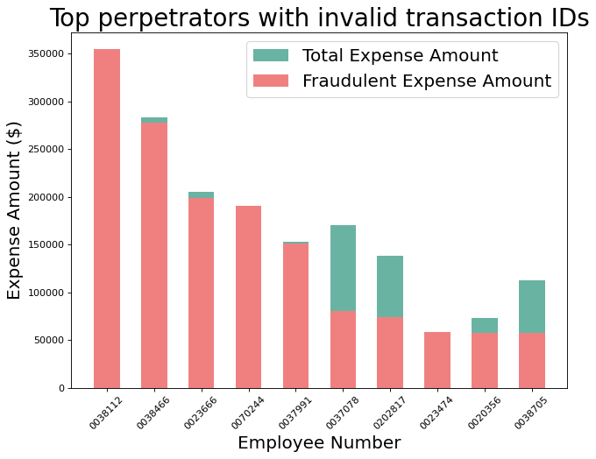
Disruptive Actors
Rule 1: Invalid Transaction IDs
Invalid transaction IDs are:
Non-numeric
Zero/NA
Flagged
Example: “NA”, “Q1”, “inv2976”
Invalid Transaction IDs found: 11,342
Total amount lost: $ 4,715,186.84
Analysis Process

Slide 16
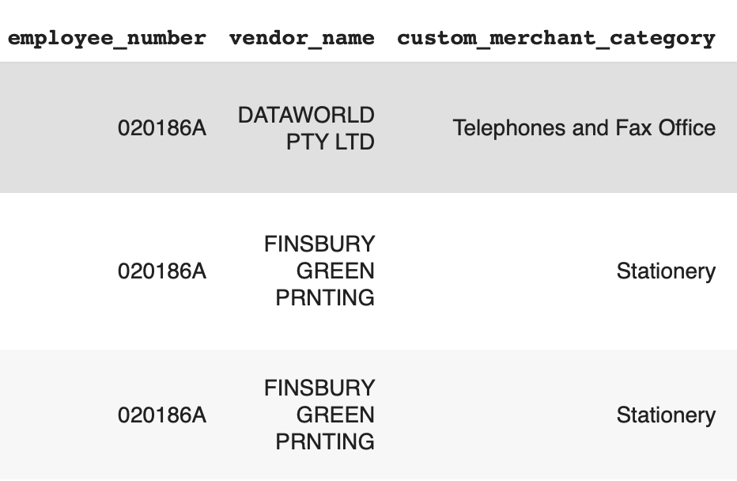
Disruptive Actors
Rule 2: Invalid Employee Numbers
Invalid employee numbers are:
Non-numeric
Zero/NA
Flagged
Example: “02186A”
3 instances of invalid Employee Numbers
Total amount lost: $ 1978.28
Examples of invalid employee numbers from Credit Card Dataset
Analysis Process

Slide 17
Disruptive Actors
Rule 3: Invalid Tax Codes
Nature of valid tax codes
P0, P1 or P2
Tax code can be left blank if transaction status is “UNSUBMITTED”
No Invalid Tax Codes Found
Analysis Process

Slide 18
Ghost
Actors
Proposed Checks & Rules
Duplicate rows (Credit Card Data)
Fake vendors (Accounts Payable Data)
Sharing of bank accounts between employees
Analysis Process

Slide 19
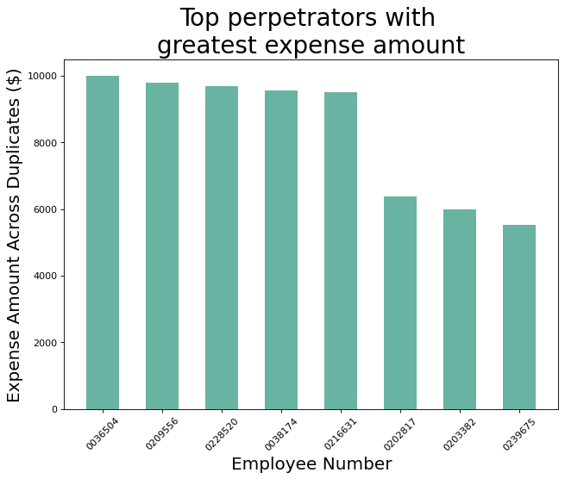
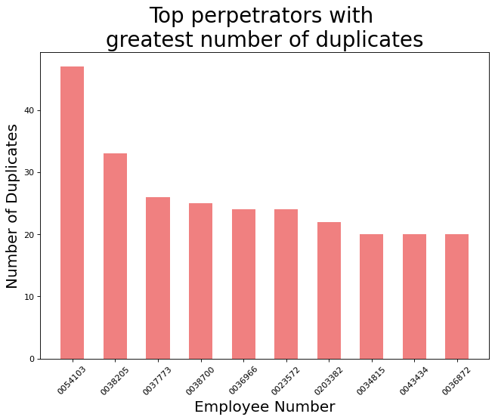
Ghost Actors
Rule 1: Duplicate rows
Rows that are 100% alike in all attributes are indicative of invalid/unauthorised transactions.
The same transactions are charged multiple times. This could indicate cash flow to dummy actors
Total Amount Lost: $ 205,786.48
Analysis Process

Slide 20
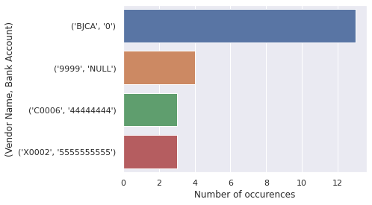
Ghost Actors
Rule 2: Unlikely Vendor Bank Accounts
Some vendor have unlikely bank accounts listed, suggesting that money could have been siphoned away as false payments .
Analysis Process

Slide 21
Ghost Actors
Rule 3: Sharing of Bank Accounts
4 Employees have been found to share 2 bank accounts. The Employee IDs are:
20186/20186A
33876/454690
Sharing Employee POC details
Continuity in work terms between 2 IDs
Country field from Singapore to Hong Kong
$776.09 spending as ‘186’ and $1978.28 spending as ‘186A’ → spread out
Conclusion: Inter-company transfer - Ghost Employee ID
Sharing Employee POC details
No continuity in work terms
No credit card records as ‘454690’
Bank account and mobile number are same
Country field Singapore while address is US
Conclusion: Suspicious Employee with credit card
transactions
Total Amount Lost: $ 2744.37
Total Amount Lost: $ 11,011.99
Analysis Process
Notes:
13756.36

Slide 22
Malicious
Actors
Proposed Checks & Rules
Employees making transactions during leave (Credit Card Data)
Negative amounts (Credit Card Data)
Amounts should tally with each other (Credit Card Data)
Payments to discontinued/deactivated vendors (Accounts Payable)
Overpayments to vendors (Accounts Payable)
Embezzlement by employees who have already left Lumbargo
Analysis Process

Slide 23
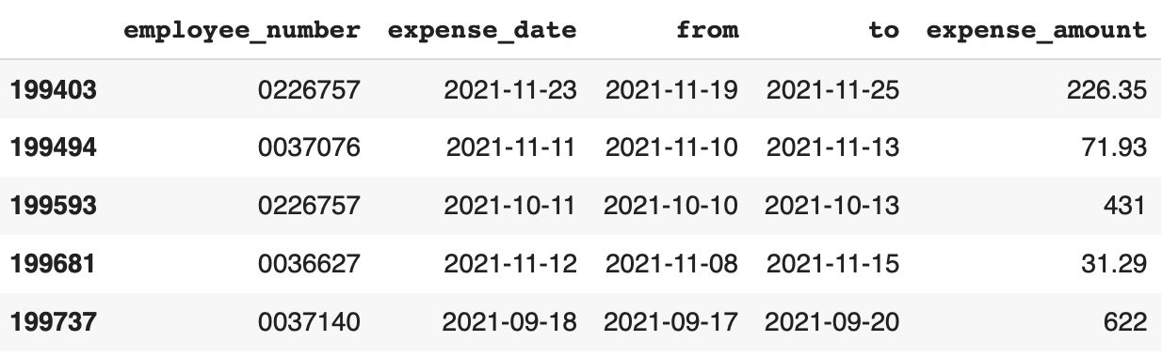
Malicious Actors
Rule 1: Employees making transactions during leave
Credit card transactions are being recorded while employees are on annual leave.
Represents a misappropriation of corporate credit card funds for personal expenses
Invalid transaction if:
Employee on leave
Employee makes transaction during leave period
Duplicated records are aggregated to 1 record loss
Examples of employees making transactions during leave
Total Amount Lost: $ 530,097.97
*Rules performed on datasets with disruptive and ghost actors removed
Analysis Process

Slide 24
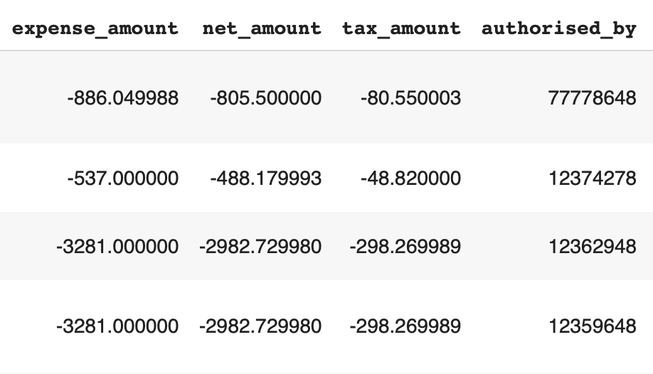
Malicious Actors
Rule 2: Negative Transaction Amounts
Some transactions have been recorded with negative expense amounts.
These are dangerous as they can hide fraudulent transactions to be viewed as accounting errors.
Identified as negative if:
Expense amount is negative
Sum of net and tax amount is negative
Total Amount Lost: $ 158,065.98
Examples of negative amounts
*Rules performed on datasets with disruptive and ghost actors removed
Analysis Process

Slide 25
Malicious Actors
Rule 3: Amounts should tally with each other
Checking the validity of transactions through accounting formula check.
Valid transactions should adhere to this formula if its status is anything but “UNSUBMITTED”:
Expense amount = net amount + tax amount
Transactions that do not adhere are flagged out
No findings*
*Rules performed on datasets with disruptive and ghost actors removed
Analysis Process

Slide 26
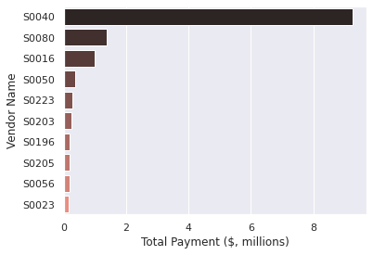
Malicious Actors
Rule 4: Payments to discontinued/deactivated vendors
Some vendors have received payments even though they are listed as discontinued or deactivated.
Total Amount Lost: $ 14,445,195.10
Analysis Process

Slide 27
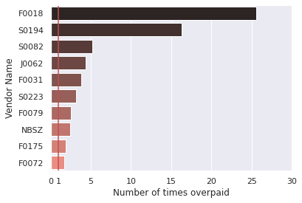
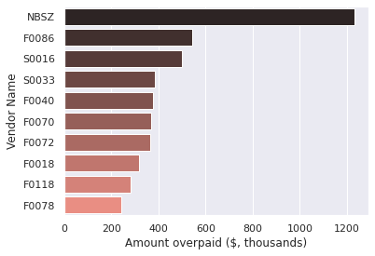
Malicious Actors
Rule 5: Overpayments to vendors
Some amounts that were under Accounts Payable Payments did not tally with the amounts that were owed to those vendors.
Fraud can occur if the bank is paying more than what is owed to the vendors.
Total Amount Lost: $ 2,066,166.93
Analysis Process

Slide 28
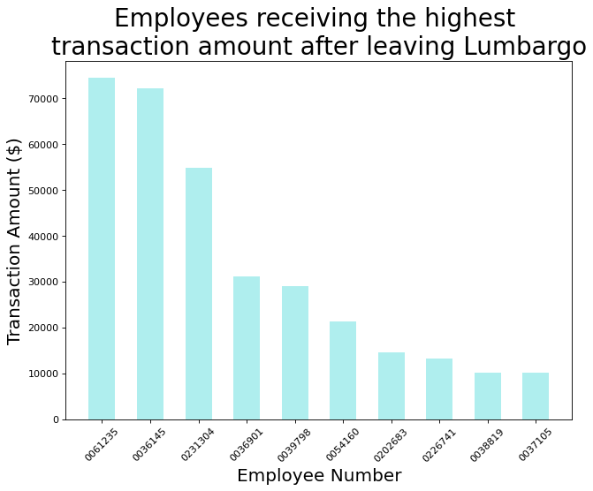
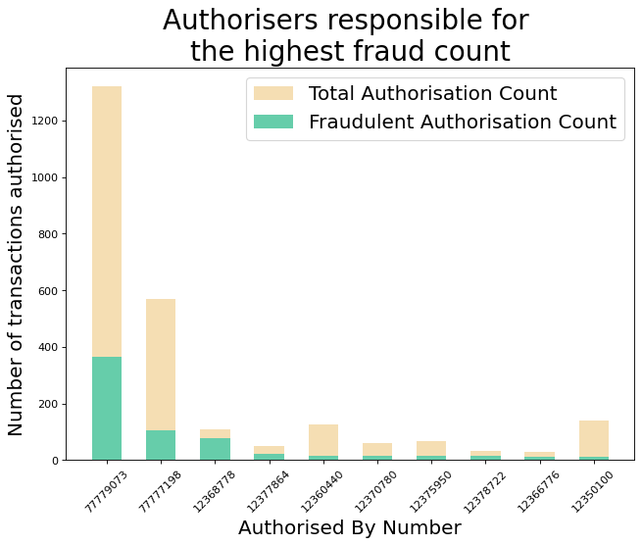
Malicious Actors
Rule 6: Embezzlement by employees who have left
Employees are still making transactions despite having already left the company as determined by either the date term specified in the dataset or the contractual end term, if they are hired on the contractual basis.
Total Amount Lost: $358,596.62
Analysis Process

Slide 29
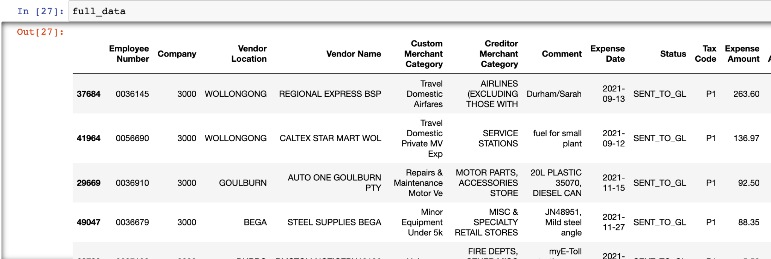
Looking Forward
Machine Learning in Fraud Detection
DBSCAN: Density Based Spatial Clustering of Applications with Noise
Preliminary Stage
Data Loading and Cleaning
DBSCAN limitations in text analysis - removal of string prevalent columns
Changing string to int/float data type
Data Processing
Standard Scaling & Gaussian Normalisation to make cross-variable comparisons
Snapshot of credit card dataset
Analysis Process

Slide 30
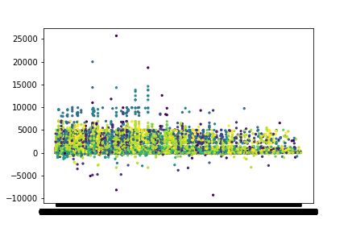


Looking Forward
Machine Learning in Fraud Detection
Model Building - Bivariate Analysis
Model Building Stage
Model Generation on normalised data
2 Optimisation Hyperparameters introduced
Epsilon
Minimum Samples
Unoptimized Model Generation -
Expense Amount against EmployeeID
Analysis Process

Slide 31
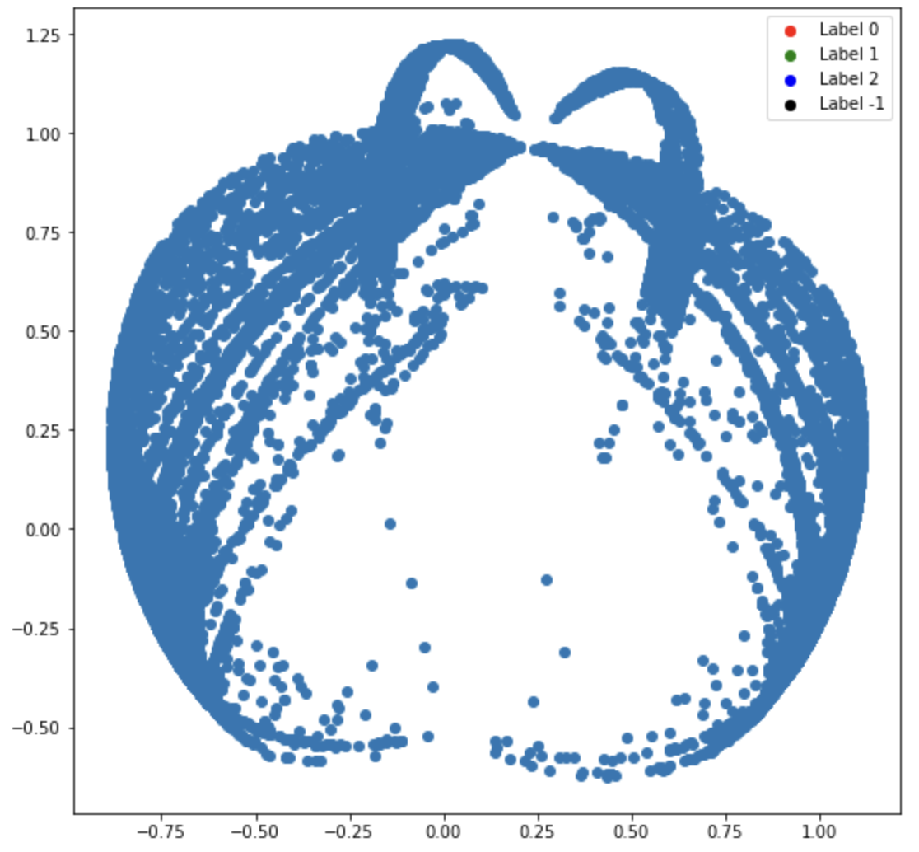
Looking Forward
Machine Learning in Fraud Detection
Model Building - Multivariate Analysis
Model Building Stage
Model Generation on normalised data
2 optimisation hyperparameters created
Sklearn.decomposition is used to find the SVD of multiple variables
Plotting of decomposed points in a 2D space for clustering
Unoptimized Model Generation -
Analysis of all variables
Analysis Process

Slide 32
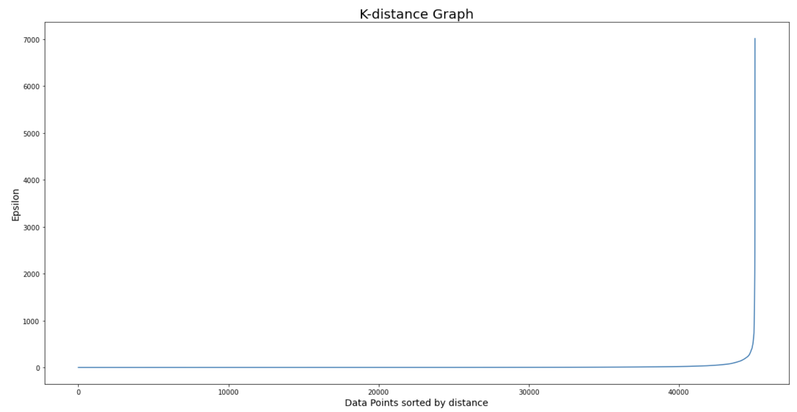
Looking Forward
Machine Learning in Fraud Detection
Model Optimisation -Bivariate Analysis
Model Optimisation Stage
Iterative Approach of reducing cost of Model
Optimisation of Epsilon Hyperparameter
No optimisation of min. samples required for bivariate analysis
Finding Epsilon at steepest gradient
of K-Means Clustering
Finding Optimised Epsilon -
Analysis of all variables
Analysis Process

Slide 33
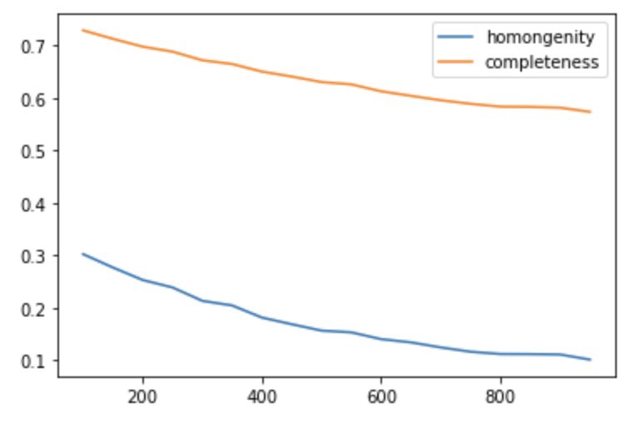
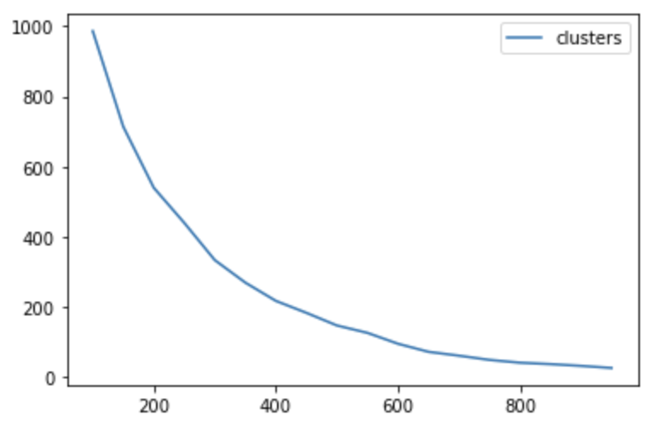
Looking Forward
Machine Learning in Fraud Detection
Model Optimisation -Bivariate Analysis
Model Optimisation Stage
Iterative Approach of reducing cost of Model
Finding optimised Epsilon through 3 Parameters
Model Completeness
Model Homogeneity
Number of Clusters
Comparison of all three Model Optimisation Parameters
Analysis Process

Slide 34
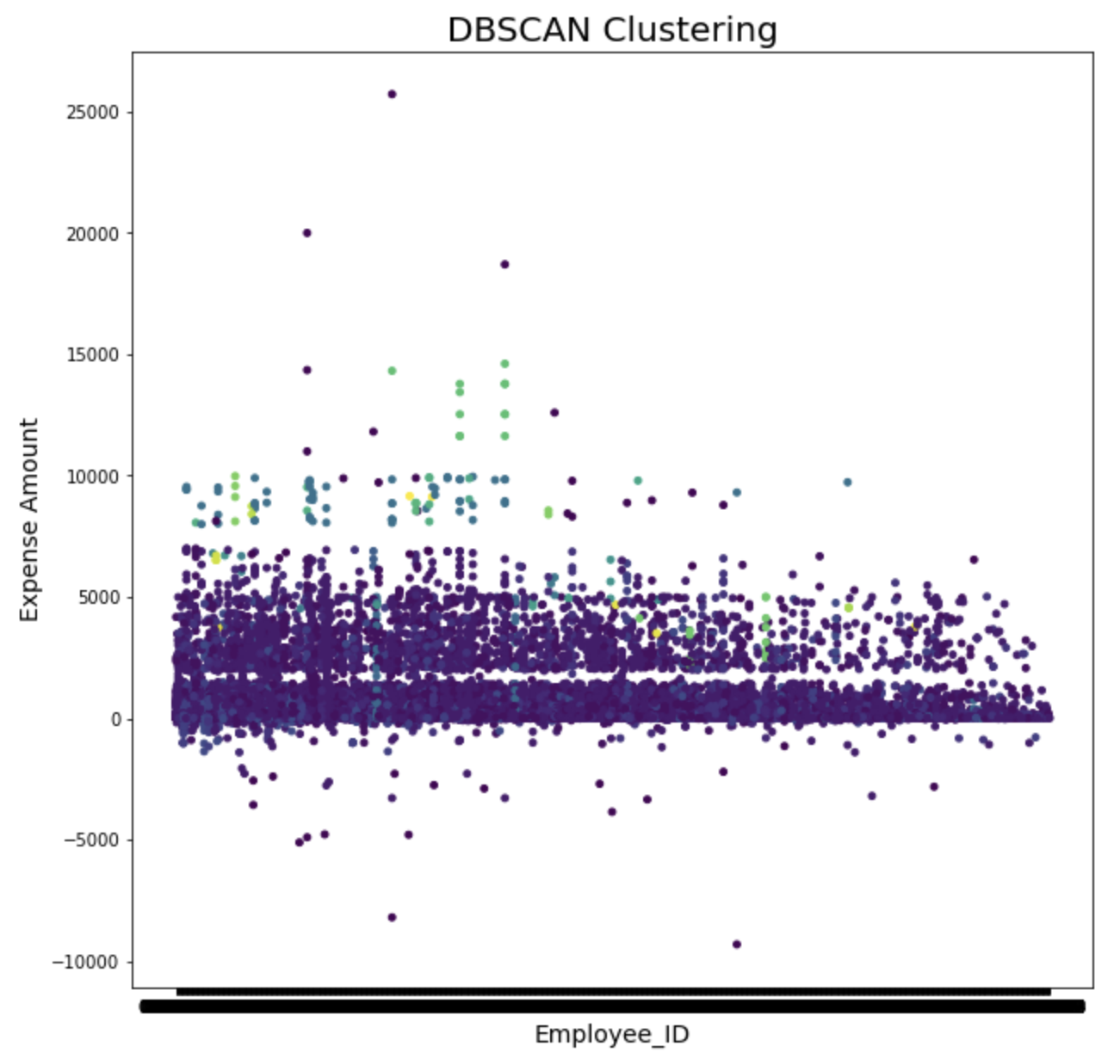
Looking Forward
Machine Learning in Fraud Detection
Optimised DBSCAN Model for Bivariate Analysis
Conclusion: Optimized Model Creation
Optimized Epsilon: 300
Optimized min. samples: 2
Steps Forward:
Identification of anomalies through pycaret anomaly detection: prescriptive analysis of fraudulent behaviour
Creation of Model with best clustering parameters
Analysis Process

Slide 35
04
Outcomes &
Insights
Outcomes & Insights

Slide 36
$22,494,831
Suspected Fraud Valuation
Outcomes & Insights

Slide 37
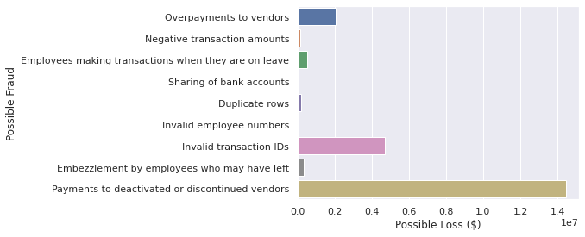
Outcomes
Which rules are the most effective?
The rule which has the highest financial impact identified was the invalid transaction IDs under the Credit Card data set, with a total potential loss of 4,715,186.84.
Outcomes & Insights

Slide 38
Outcomes
Which risk profile is the most prolific?
The Malicious Actor risk profile is the most prolific, as such actors have the highest number of possible rules. We also observe the highest number of observations where employees are committing fraud by exploiting difficult to notice loopholes such as crediting the company for their transactions even after they have left the company, as well as having their fraudulent transactions being approved by a small group of “fraudulent authorisers.”
These risk profiles address the danger of system administrators - such as identified authorisers - for approving large numbers of fraudulent transactions. By taking a identity agnostic approach using Machine Learning models such as DBSCAN, credit card transactions are flagged as fraud by their natural characteristics rather than the approval of other parties.
Outcomes & Insights

Slide 39
05
Recommendations
Recommendations

Slide 40
Recommendation
Handling Disruptive Actors
Disruptive actors exist due to the lack of input control
Input control can be implemented in the following ways:
User interface restricts type of input e.g. no alphabets in transaction ID input
User interface requires certain inputs to be keyed in for a transaction to be recorded
Normalised database implementation will restrict duplicate primary keys e.g. duplicate transaction IDs
Recommendations

Slide 41
Recommendation
Handling Ghost Actors
Strong internal controls
Stringent access controls to authorise and verify employees
Multiple user access levels i.e. do not give access to employees that they do not need
Aim: Prevents ghost actors from accessing system
Decentralised processes
Actor making transaction should not be able to authorise his/her own transactions
Aim: Prevents ghost actors from being able to make transactions from one point of access
White-listing
List of pre-approved vendors should be updated on a regular basis
Aim: Prevents money from flowing out to fake/outdated vendors
Recommendations

Slide 42
Recommendation
Handling Malicious Actors
After sieving out disruptive actors and ghost actors, a more complex approach must be taken to detect malicious actors
Rules developed in this case will be useful in flagging out future similar occurrences
Increasing sophistication of malicious actors require an adaptive & constantly evolving approach to fraud detection
Regular data mining & analytics is required to pick up on new trends and develop new rules
A strong whistleblower program generates good starting points for data exploration and analytics
Recommendations

Slide 43
Thank You
Investigating Fraud Utilising Advanced Analytical Techniques
NBS BAC Hackathon
VSLAM
Ananya Balehithlu | Bai Shun Yao | Max Tan Zheyuan
Tan Kit Hon, Luke | Vinay Krishnaa Vinod

